Slide 1

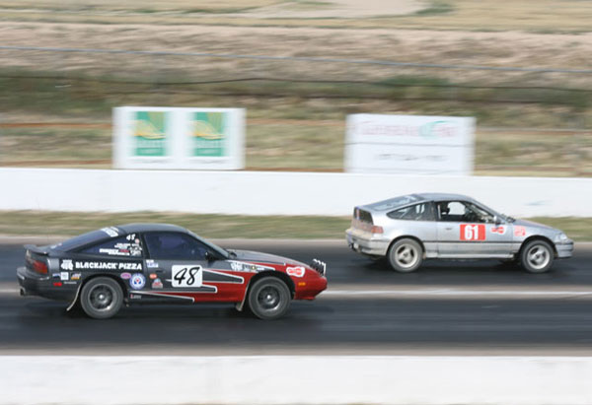
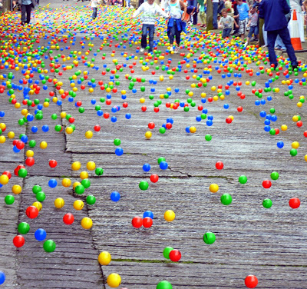
Review: The “Famous Five” Kinematics Equations for Uniform Acceleration

Slide 2
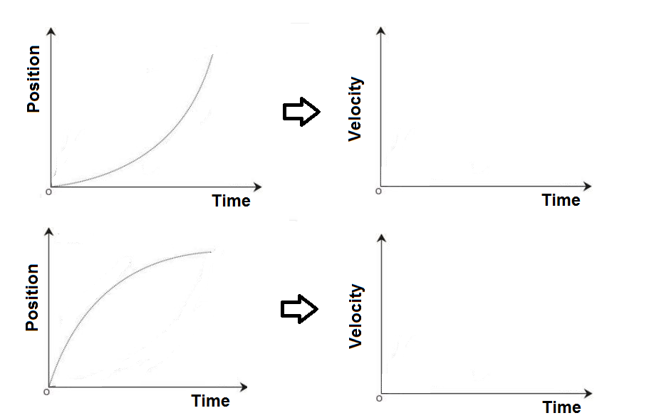
Uniform Acceleration-Warm Up
What do the corresponding v-t graphs look like for the following motions?

Slide 3
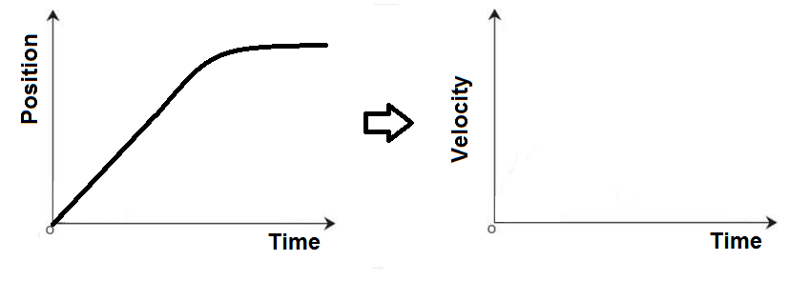
Combo Problems Warm up- What does the corresponding v-t graphs look like for the following motion?

Slide 4
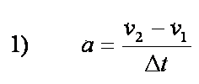




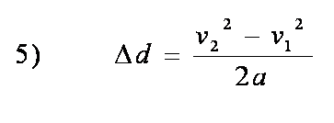
Kinematics Equations for Uniform Acceleration
OR

Slide 5
Application
For each problem:
Identify the variables (given and unknown)
Identify the appropriate equation to solve for the unknown.
Rewrite the equation as needed.
Solve the problem!
You throw a rock off a cliff, giving it a velocity of 8.30 m/s [down]. At the instant you drop the rock, your hiking buddy begins timing the falling rock on his phone. You hear the splash 6.90 s later when the rock lands in the river below. How high is the cliff above the river? ( Ans: 291 m)

Slide 6
2. A car travelling at 24.0 m/s [West] accelerates uniformly at 1.50 m/s² [East] when it enters a school zone. The car reaches a final velocity of 18.0 m/s [West]. For how long did it accelerate? (Ans: 4.00 seconds)

Slide 7
3. A race car accelerates at 5.00 m/s² [Forward]. If it has a final velocity of 200.0 km/h [Forward], how far has it travelled after 8.00 seconds?
(Ans: 284 m)

Slide 8
4. A clown throws a juggling ball up in the air with an initial velocity of 8.00 m/s [ up]. How far up in the air will the ball rise? (Ans: 3.27 m)

Slide 9
5. An airplane lands on a runway moving at 280.0 km/h [ East]. After travelling 200.0 m along the runway the plane has slowed down to 30.0 km/h [East]. What time has it taken to reach this final velocity?
(Ans: 4.65 seconds)

Slide 10
Combo Problems!
6. A car travels east along a straight road at a constant velocity of 18.0 m/s. After 5.0 seconds, it accelerates uniformly for 4.00 seconds. When it reaches a velocity of 24.0 m/s, the car proceeds with uniform motion for 6.00 seconds. Determine the car’s total displacement during the trip. (Ans: 318 m [E])

Slide 11
While driving to school one morning at a constant velocity of 60.0 km/h [East], Ms. Ryan sees a truck suddenly stop up ahead as a squirrel runs across the road. It takes Ms. Ryan 200.0 ms to react and put on the brakes. Her car accelerates uniformly at 2.5 m/s² [West] once the brake is applied.
a) Draw sketches of the velocity-time and displacement time graphs representing Ms. Ryan’s motion.
b) If the truck was 60.0 m ahead of her when she first saw it stopped, will Ms. Ryan be able to stop in time? (Ans: Luckily yes!!)

